Slide 1
Year 7 Successful Learning Evening 2020
Wednesday 9th September 2020
Online

Slide 2
The Waddesdon Way
Dignity and respect (core values)

Slide 3
Head of Year Role
To enable students to flourish so that they live a full and rich life
“I have come in order that you might have life—life in all its fullness” John 10:10
Safety, health, academic and social well-being, including mental health
To promote positive relationships and feeling safe
Helping students to make good choices
Myself and Form Tutors – here to help

Slide 4
Head of Year Role
Overseeing the Year 7 curriculum
SMHW
Monitoring behaviour
Monitor attendance
Website : www.waddesdonschool.com

Slide 5
The importance of behaviour
Good behaviour correlates with good progress
Very high expectations (dignity and respect)
EVERY child behaves well, and EVERY teacher can teach
Behaviour outside lessons (including on bus)
A note about exclusions

Slide 6
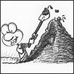
The Key Stage 3
Mastery Curriculum
Surface
Deepening
In depth
Profound
Parent Booklet
Mastery Bands
Depth and not superficial breadth
Practice makes perfect
Preparing for KS4
Regular reporting

Slide 7
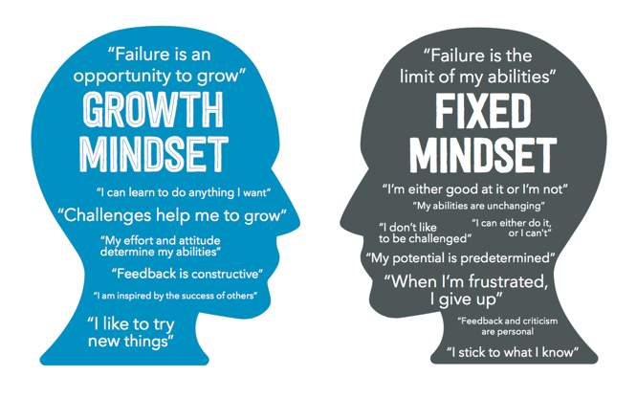

Slide 8
Internet safety
Talk to each other!
Privacy settings – “private”
Group environments online (live chat)
Photos
WhatsApp groups

Slide 9
The support you give at home continues to be vital
Take an interest in your child’s learning:
What did you learn today?
What have you worked hard at today?
What were today’s challenges?
What did you do at break/lunch?
Establish good homework habits and a space to study
Encourage reading, spelling, times tables
Praise effort and model it yourself
Home / school partnership

Slide 10
Key Dates
Inset day – 23rd September
Green Park activity day – 5th to 9th October
Report 1 issued – 10th November
Parents Consultation Evenings – 11th November, 22nd April
Christmas carol service – 15th December

